Slide 1

Fortnite Ping
Tiny Seed December 2, 2019

Slide 2
Why?
Fortnite generated and estimated $2.4 billion for Epic games in 2018.
Epic’s 2019 Fortnite World Cup had a prize pool of $100 million, spread across ~19,000 players worldwide.
Emerging ecosystem of organizations, players and vendors needs a single place to go for information.

Slide 3
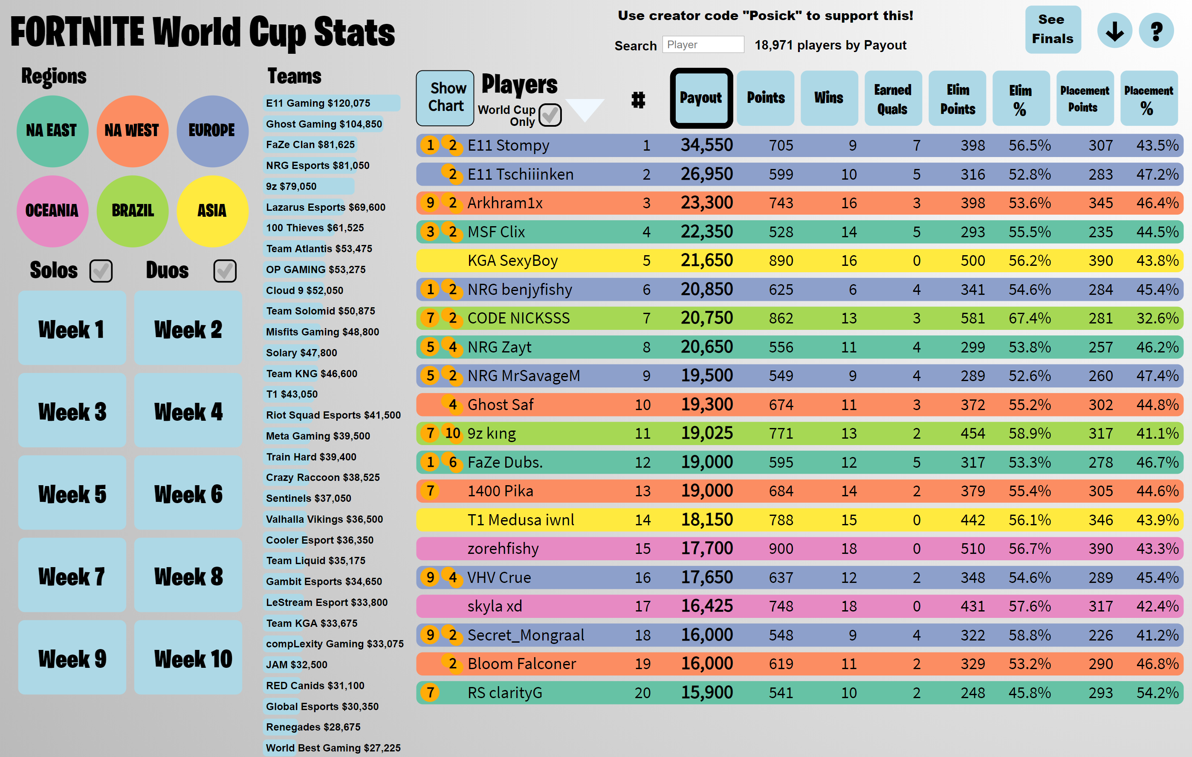
Launch
Site launched in May 2019, and covered World Cup qualifiers

Slide 4
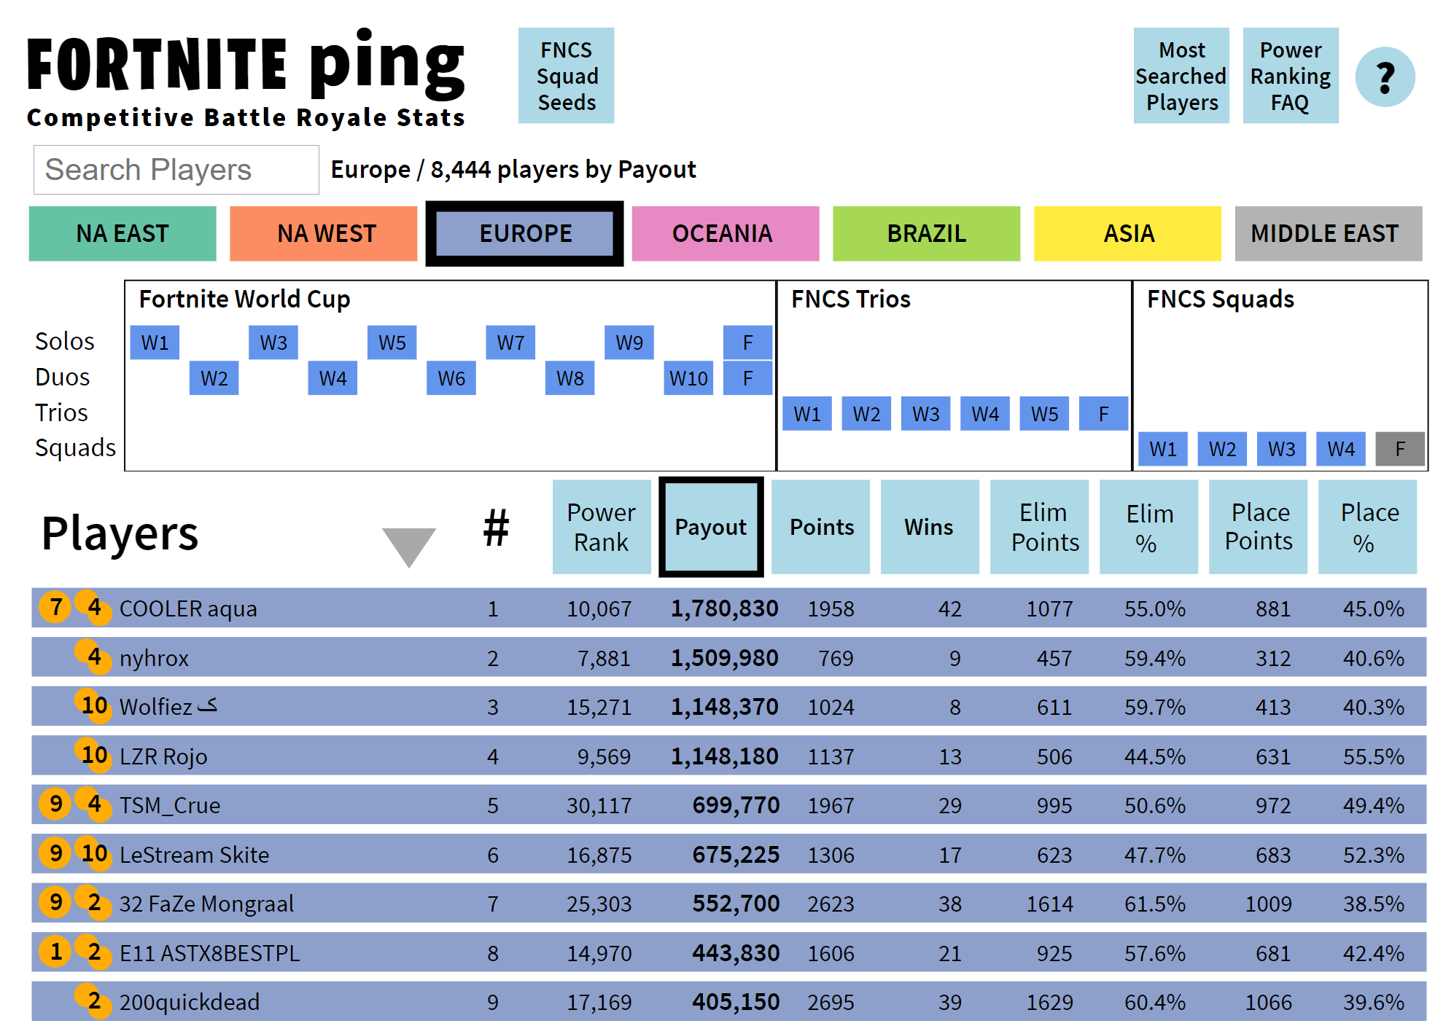
Progression
Since World Cup, expanded to cover trio and squad formats in “Champion Series”

Slide 5
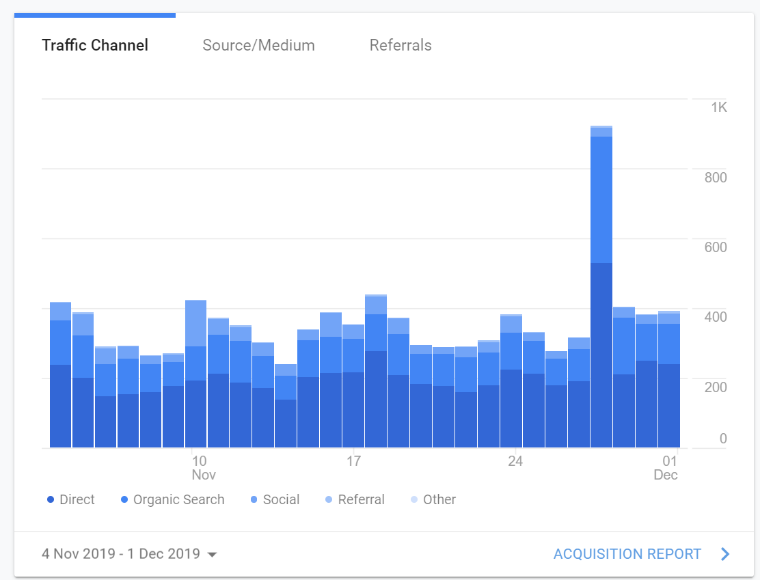
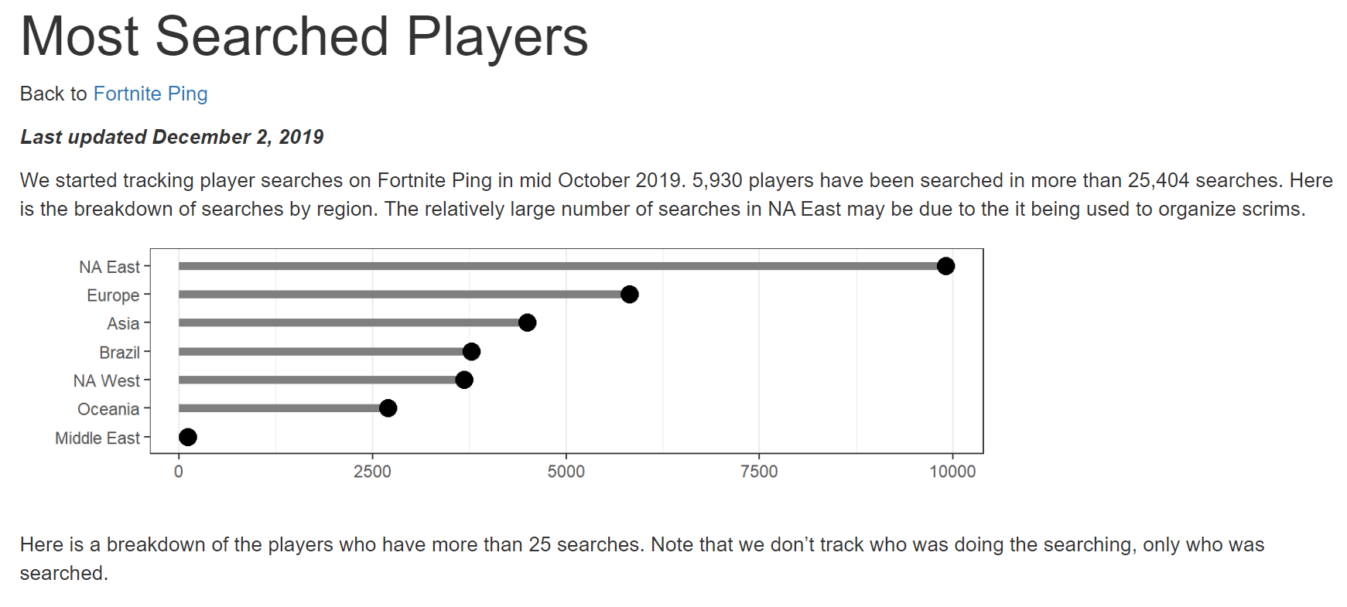
Users
300-400 unique users per day, 1000+ when there areTwitter mentions.

Slide 6
Developer/Founder
Scott McKissock, dev lead at US Agency for International Development
25+ years of “full stack” development, plus expertise in d3.js, and R/ggplot
430 part-time hours invested in project to date.
Father of professional Fortnite player who advises on site direction.

Slide 7
Revenue Sources
Epic’s 2019 Fortnite World Cup had a prize pool of $100 million, spread across ~19,000 players worldwide.
Epic has committed to further events, and emerging ecosystem of organizations, players and vendors needs a single place to go for information.

Slide 8
Fortnite generated and estimated $2.4 billion for Epic games in 2018.
Epic’s 2019 Fortnite World Cup had a prize pool of $100 million, spread across ~19,000 players worldwide.
Epic has committed to further events, and emerging ecosystem of organizations, players and vendors needs a single place to go for information.

